Slide 1
读书派booklist免费出品
禁止任何二次分享、售卖
本人法律专业，请勿以身试法
读书派booklist免费出品
这部分内容不影响PPT播放
尊重原创，请勿以身试法，二次分享或倒卖
IEOR E4574 Prediction： A Real-World Application
Sales Forecasting
Wenxin Zhang (wz2585)
Yajie Zhang (yz3876)
Ran Liao (rl3303)

Slide 2
读书派booklist免费出品
禁止任何二次分享、售卖
本人法律专业，请勿以身试法
读书派booklist免费出品
这部分内容不影响PPT播放
尊重原创，请勿以身试法，二次分享或倒卖
01
Introduction
02
Data Extraction
CONTENT
03
Data Preparation
04
Modeling
05
Results

Slide 3
读书派booklist免费出品
禁止任何二次分享、售卖
本人法律专业，请勿以身试法
读书派booklist免费出品
这部分内容不影响PPT播放
尊重原创，请勿以身试法，二次分享或倒卖
01
Introduction

Slide 4
Problem & Business Value
Objective: Optimize the previous group’s work to predict daily Gross Merchandise Value (GMV) with better accuracy and reasonable features
Value Creation:
Understanding GMV figure are key metric for revenue traction and performance tracking for eCommerce
Potential to optimize logistics and manpower management accordingly

Slide 5
Changes & Optimization
Data Processing
Remove duplicate records to avoid double counting
Remove cancellations and refunds as they are irrelevant to GMV
Add visualization and feature selections based on the original dataset
Feature Engineering
Add weather-related features (only for neural network approach)
Remove feature quantity
Modeling
Facebook Prophet (without quantity and poorly correlated feature)
ARIMA (without quantity and poorly correlated feature)
SARIMAX (newly added)
Neural Network (newly added)

Slide 6
读书派booklist免费出品
禁止任何二次分享、售卖
本人法律专业，请勿以身试法
读书派booklist免费出品
这部分内容不影响PPT播放
尊重原创，请勿以身试法，二次分享或倒卖
02
Data Extraction
读书派booklist免费出品
禁止任何二次分享、售卖
本人法律专业，请勿以身试法
读书派booklist免费出品
这部分内容不影响PPT播放
尊重原创，请勿以身试法，二次分享或倒卖

Slide 7
Original Dataset
Source: Online Retail II dataset from UCI Machine Learning Repository
Dataset:
Transactional data from online retails between 01/12/2019 and 09/12/2011 for all-ocassion giftware
Attributes (#):
Country, Invoice, StockCode, Price ($), Quantity (#), Description, InvoiceDate, CustomerID

Slide 8
External Dataset
Source: Office for National Statistics (UK based) and Kaggle
Dataset:
Average earnings (wages) in the UK
Retail sales in the UK
Monthly unemployment rate in the UK
Daily weather conditions in the UK
Attributes (#):
Unemployment Rate, Retail Spending Monthly, Average Wage, Cloud_cover, Sunshine, Global_radiation, Max_temp, Mean_temp, Min_temp, Precipitation, Pressure

Slide 9
读书派booklist免费出品
禁止任何二次分享、售卖
本人法律专业，请勿以身试法
读书派booklist免费出品
这部分内容不影响PPT播放
尊重原创，请勿以身试法，二次分享或倒卖
03
Data Preparation
读书派booklist免费出品
禁止任何二次分享、售卖
本人法律专业，请勿以身试法
读书派booklist免费出品
这部分内容不影响PPT播放
尊重原创，请勿以身试法，二次分享或倒卖

Slide 10
Data Diagnostics
UK sales accout for ~92% of data
Much higher GMV occur during November
1
2
3
4
Location
Negative Values
Seasonality
Outlier
Refunds and cancellation represented by non-positive price and quantity
A high spike occur at the end of the two years

Slide 11
Data Filtration
Original:
Restrcited to sales in the UK
# Observations: 981331
Modified:
Filtered out overlapped timespan transactions (between 2010-12-01 and 2010-12-09) to avoid double counting
Restricted to UK only sales
# Observations: 926584

Slide 12
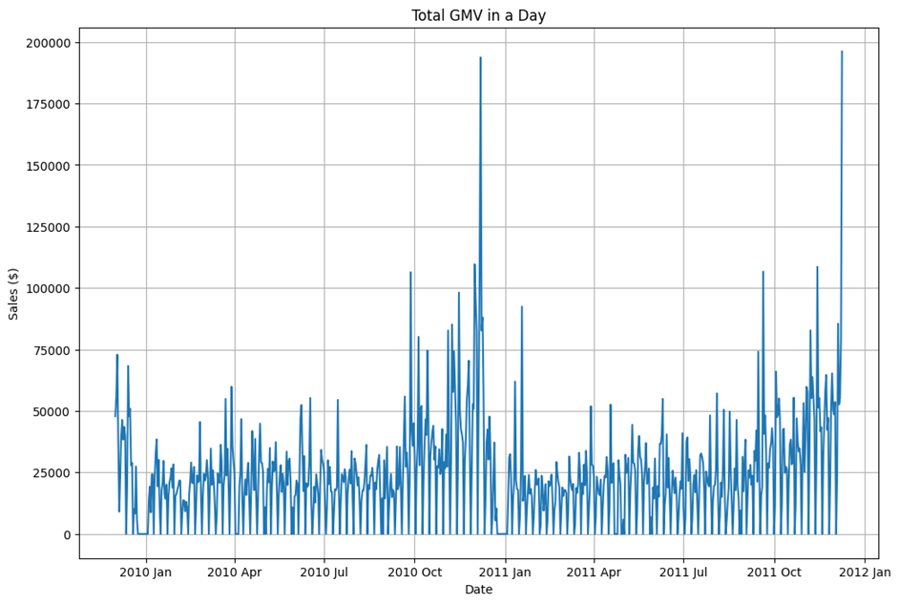
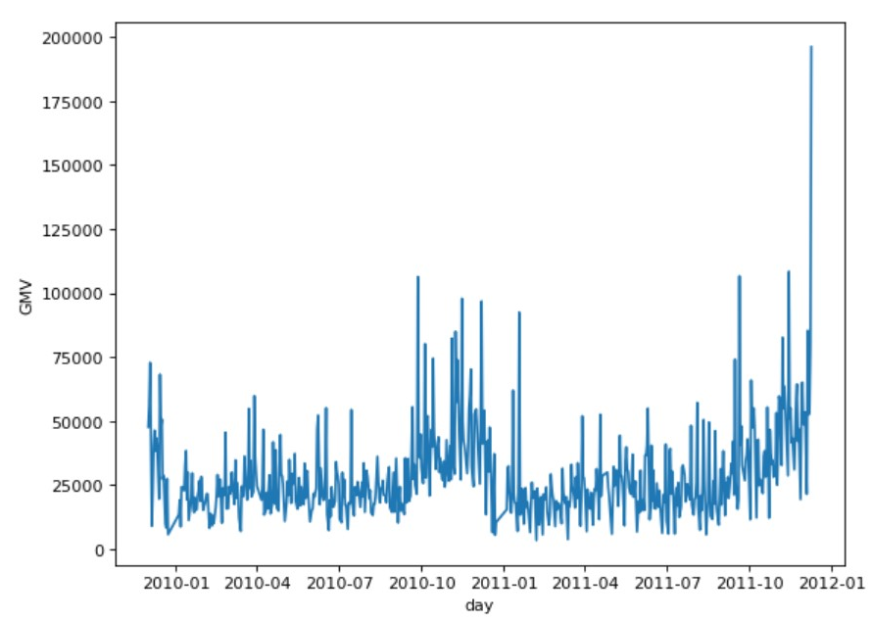
Daily GMV
Original:
Modified:

Slide 13
Data Cleaning
Original:
Restricted to transactions having non-negative quantity
Removed 0 GMV on holidays and saturdays
Replaced extreme values during the holiday season by 7 day moving average values
# observations: 598
Modified:
Removed transactions with negative price and quantity to get rid of all the refunds and cancellations
No GMV of value 0
Replaced extreme values during the holiday season by 7 day moving average values
# observations: 603

Slide 14
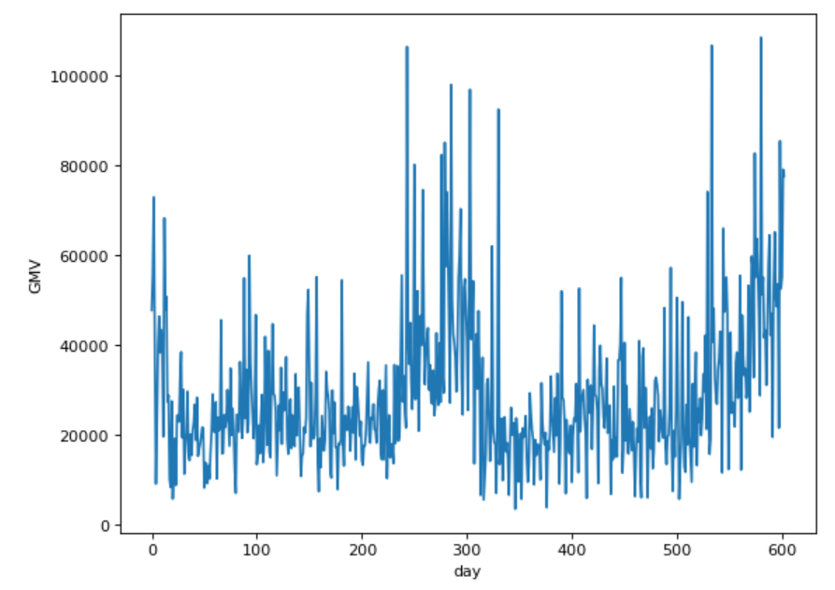
Target Variable
Daily Gross Merchandise Value (GMV)
= Sales Price of Goods x Number of Goods Sold
aggregated by day

Slide 15
Feature Selection
Original:
Predictive Variables:
Quantity*
Average monthly earnings
Monthly retail spending
FTSE 100 historical price
Monthly unemployment rate
Modified:
Predictive Variables:
Unemployment Rate
Retail Spending Monthly
(Features below are only included in Neural Network model)
Cloud_cover
Sunshine,
Global_radiation
Max_temp/Mean_temp/Min_temp
Precipitation
Pressure

Slide 16
Reasons for feature removal
Feature quantity is removed for two reasons:
Given that GMV is quantity * price, using quantity as a predictor which is highly related to the target over-estimate the accuracy of such a model
In real life, quantity wouldn’t be available for sales forecasting and therefore deems as an implausible approach
Feature Average Wage is removed because it has a correlation with GMV < 0.1
In general, we do not use any feature with a correlation coefficient between -0.1 and 0.1

Slide 17
读书派booklist免费出品
禁止任何二次分享、售卖
本人法律专业，请勿以身试法
读书派booklist免费出品
这部分内容不影响PPT播放
尊重原创，请勿以身试法，二次分享或倒卖
04
Modeling
读书派booklist免费出品
禁止任何二次分享、售卖
本人法律专业，请勿以身试法
读书派booklist免费出品
这部分内容不影响PPT播放
尊重原创，请勿以身试法，二次分享或倒卖

Slide 18
Train & Test Split
Original:
Model is trained with 3-fold cross validation on 75% of the data
Remaining 25% is used to test the resulting model
Modified:
Model is trained 85% of the data given the small sample size
Remaining 15% is used to test the resulting model

Slide 19
Models
Original:
Facebook Prophet
poor performance compared to SARIMA
SARIMA with manual hyperparameter tuning
time-consuming
Modified:
Facebook Prophet
ARIMA using auto-arima
SARIMAX using auto-arima
Neural Network with additional features

Slide 20
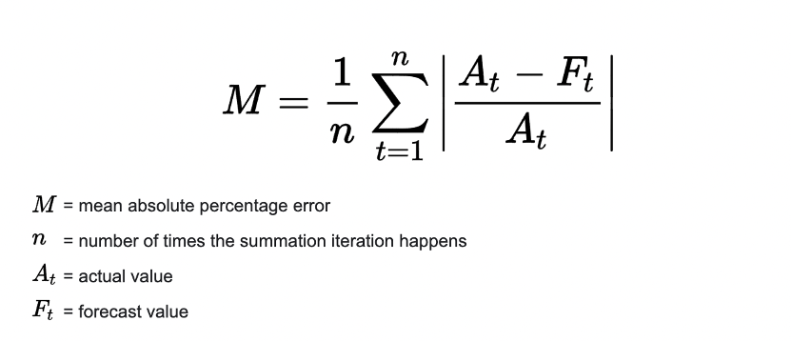
Evaluation Metric
MAPE: mean or average of the absolute percentage errors of forecasts

Slide 21
读书派booklist免费出品
禁止任何二次分享、售卖
本人法律专业，请勿以身试法
读书派booklist免费出品
这部分内容不影响PPT播放
尊重原创，请勿以身试法，二次分享或倒卖
05
Results
读书派booklist免费出品
禁止任何二次分享、售卖
本人法律专业，请勿以身试法
读书派booklist免费出品
这部分内容不影响PPT播放
尊重原创，请勿以身试法，二次分享或倒卖

Slide 22
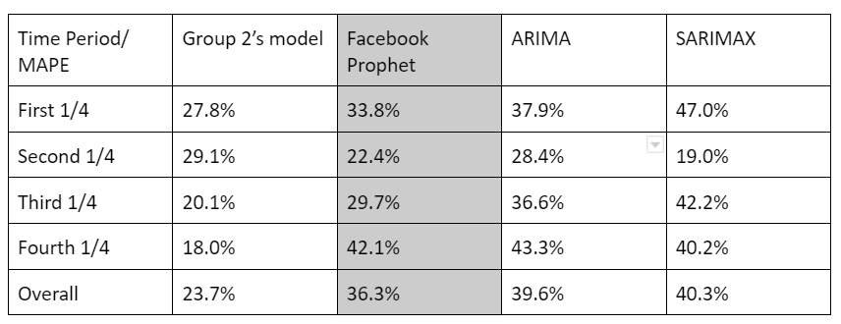
Model Evalution
Note: removing the quantity from their own model arrived in a value of 49.4% for MAPE. So, all of our models outperform theirs.

Slide 23
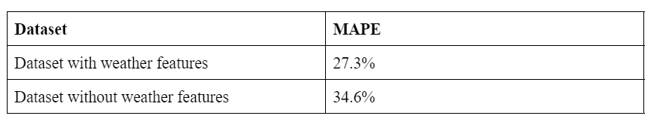
Model Optimization
We have tried neural network to further improve the predictions and it shows that by using another external dataset: weather information helps further improve the prediction accuracy.

Slide 24
Conclusion
Facebook Prophet did a better job of predicting GMV with proper features (originated from Group 2)
Weather data helps optimize the model’s predictions further, demonstrated by the usage of neural network and result comparisons
Data Extraction
Modeling
Conclusion
Problem and Business Value
Data Processing
Results

Slide 25
读书派booklist免费出品
禁止任何二次分享、售卖
本人法律专业，请勿以身试法
读书派booklist免费出品
禁止任何二次分享、售卖
本人法律专业，请勿以身试法
读书派booklist免费出品
这部分内容不影响PPT播放
尊重原创，请勿以身试法，二次分享或倒卖
读书派booklist免费出品
这部分内容不影响PPT播放
尊重原创，请勿以身试法，二次分享或倒卖
THANK YOU
读书派booklist免费出品
禁止任何二次分享、售卖
本人法律专业，请勿以身试法
读书派booklist免费出品
这部分内容不影响PPT播放
尊重原创，请勿以身试法，二次分享或倒卖

